Slide 1
PRIMARY TASTER ACTIVITY: WONDERFUL WINGS
Learn about the development of the Spitfire and why RW388 has clipped wings. Explore the four forces for flight. Investigate the four forces for flight by creating and flying your own Spitfire.

Slide 2
LEARNING OBJECTIVES:
To identify the four forces for flight- thrust, drag, weight and lift and recognise that for a plane to fly these forces must be balanced.
To investigate through observation and measurement how changing variables affects flight.
ENQUIRY SKILLS:
Comparative and Fair Testing

Slide 3
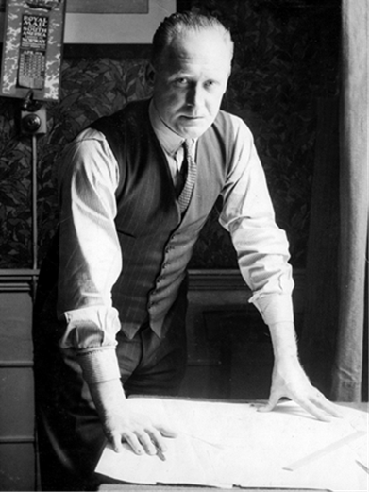
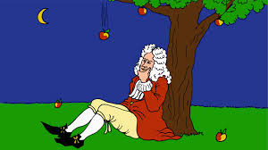
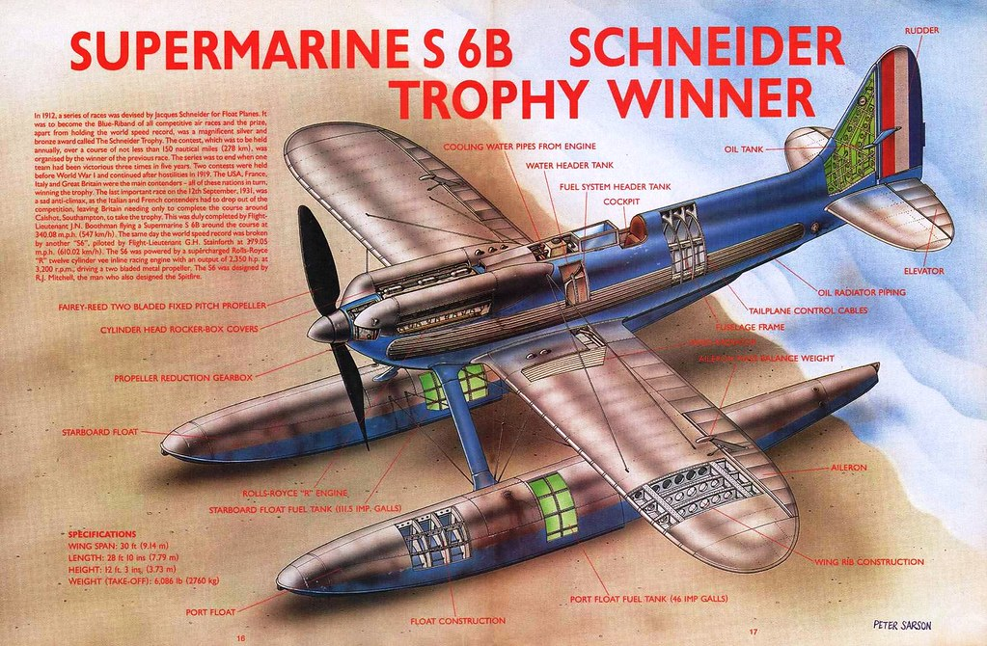
Where was Reginald Mitchell from? | What are forces?
What force makes an object fall back down towards the ground? | Why do some objects float and some objects sink?
Forces are pushes and pulls that act on an
object.
Stoke-On-Trent
Up thrust acts on an object to make it float in a fluid. If an object is less dense than a liquid it will float.
Gravity
Notes:
Upthrust acts on an object to make it float in a fluid.
Density is a measure of how heavy something is compared to it’s size.
If an object is more dense (heavy) than the fluid it will sink
but if it is less dense than the fluid it will float.
The plane is heavy but the weight is spread out over a large surface area
so it floats.

Slide 4
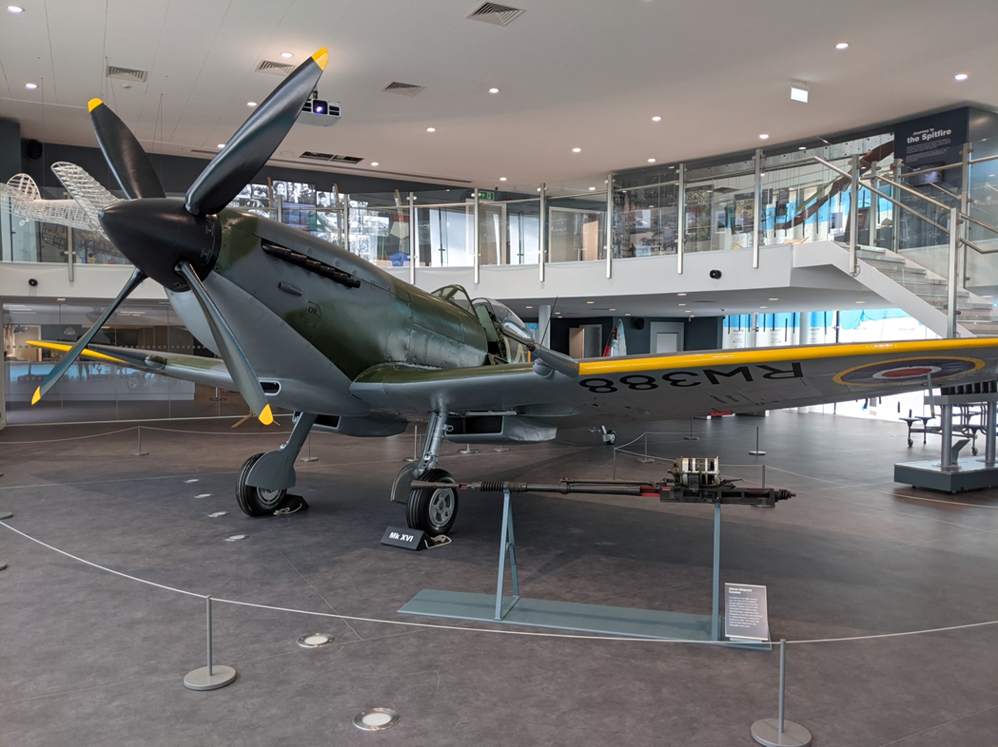
The Spitfire is one of the most famous World War 2 fighter aeroplanes in history.
The museum’s Spitfire is called RW388.
Notes:
The Spitfire is one of the most famous World War 2 fighter airplanes in history and was designed by Reginald Joseph Mitchell from Stoke-On-Trent. With their partner ask children to discuss which part of the aeroplane they think is the most important and why? Wings are one of the most important parts of the aeroplane. Without the wings it can’t fly

Slide 5
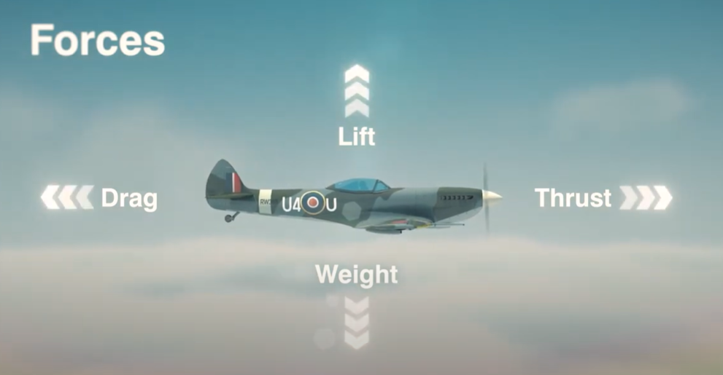
Aeroplanes need four different scientific forces to fly: Thrust, drag, weight and lift. They act against each other.
For a plane to fly they have to be balanced. This is Isaac Newton's third law. “To every action there is an equal and opposite reaction.”

Slide 6
Watch the video on YouTube

Slide 7
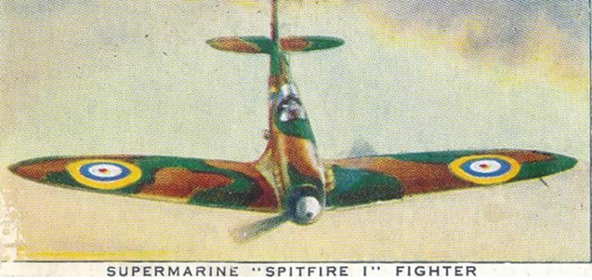
Spitfires with elliptical rounded wings had a big surface area and lots of lift.
They could fly fast, climb high in the sky and turn quickly.

Slide 8
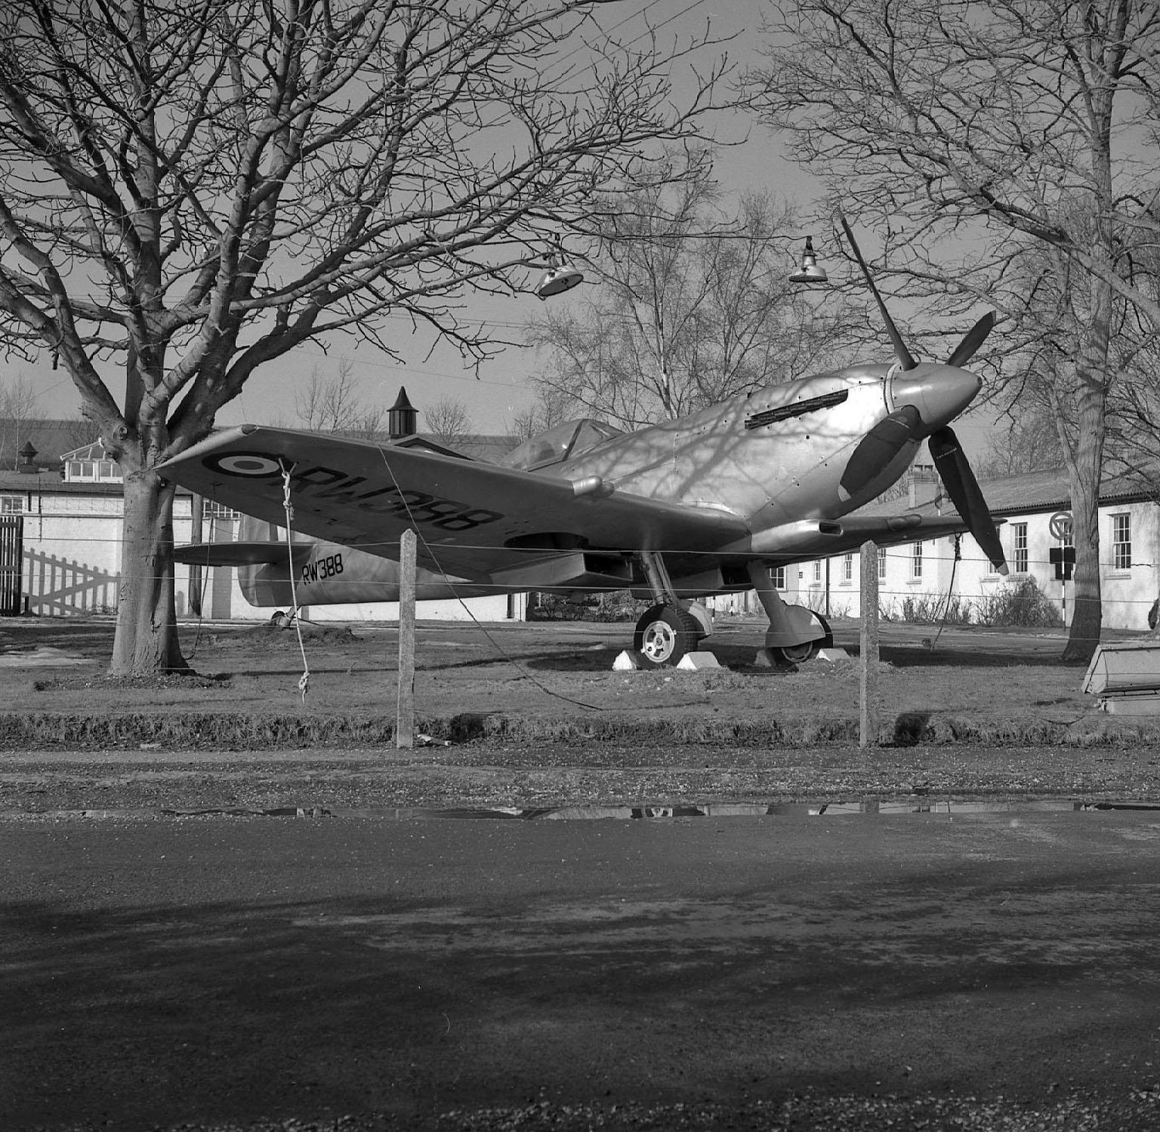
Spitfires with clipped square wings like RW388 had a shorter surface area and less lift.
They flew more slowly but the pilot had more control over the plane when it was lower in the sky.

Slide 9
Watch the video to find out about the different wing tips.

Slide 10
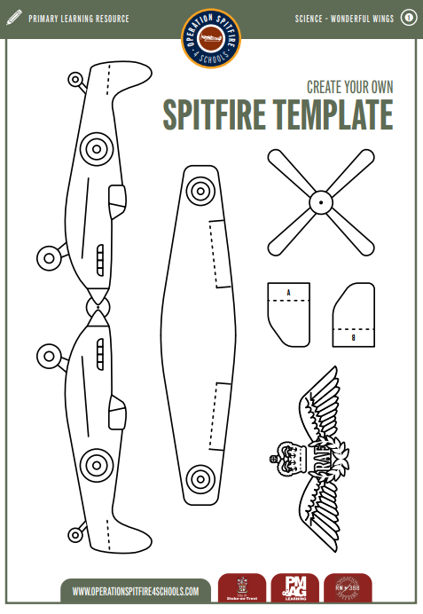

Slide 11
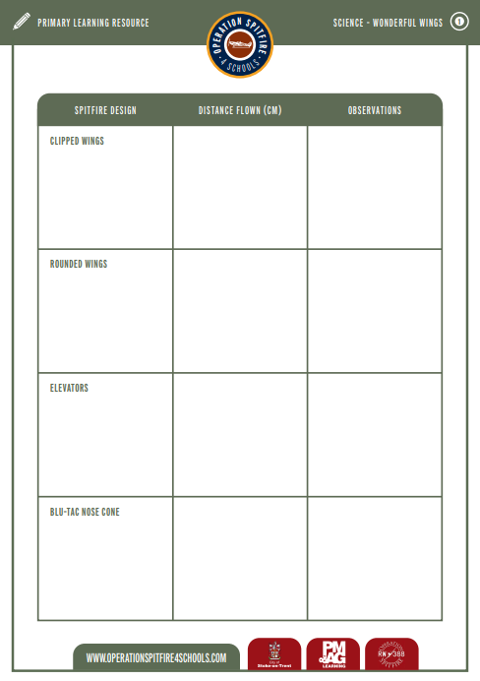
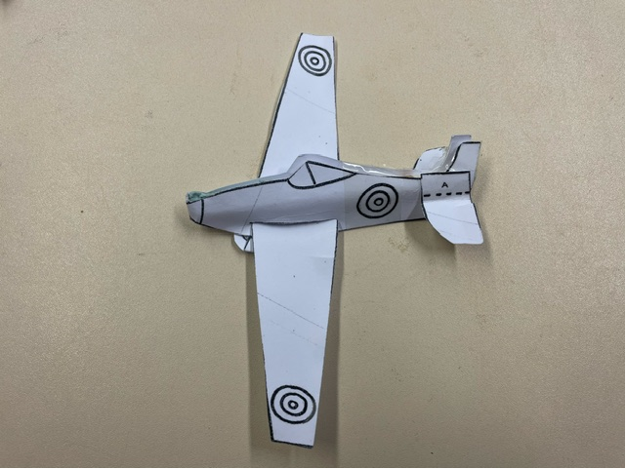
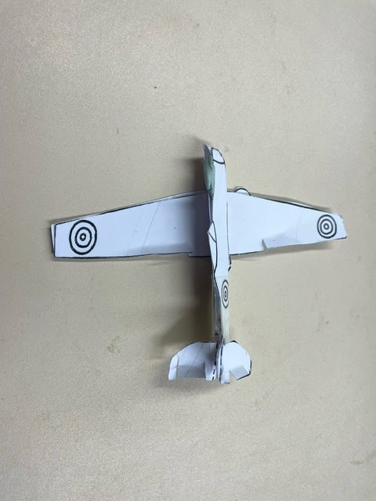
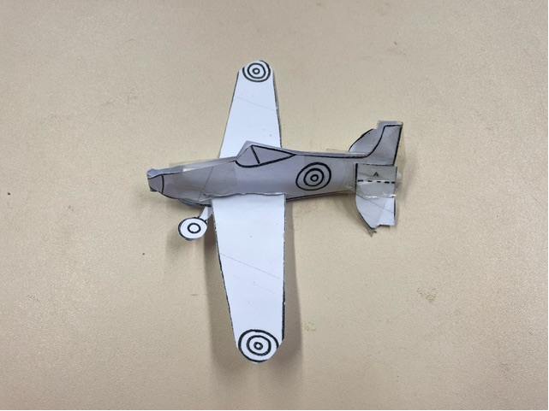
Clipped Wing
Elevators and Blu-Tac Nose Cone
Rounded Wing
You are going to be aeronautical engineers.
In the table note down your observations each time the design changes. Measure how far the Spitfire flies each time.
Notes:
Explain to children that they are going to be making their own Spitfire. They will need a card template and a straw. Model how to make the Spitfire with clipped wings. Put the straw in the middle of the body once you have folded it in half and secure in place with selotape. Score along the line so you have a hole for the wings. Throw the Spitfire will clipped wings.. Now round the wings with scissors. What do the children notice? How does the way the Spitfire flies change? Snip two cuts on each side of the tail and lift them up to create elevators. Does this change how it flies? Place a small piece of blu-tac on the end of the straw. This will weight the plane so the forces on it are balanced. Experiment with different amounts of blu-tac. Note down any observations.

Slide 12
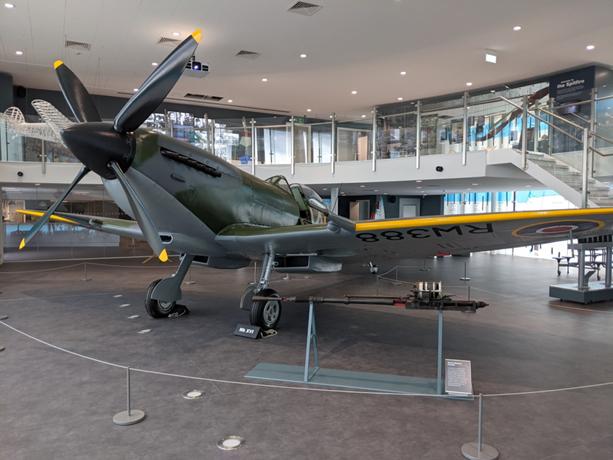
REFLECTIONS:
The Operation Spitfire values are:
Creativity
Curiosity
Inclusion
Relevance
Which of these values have you noticed in this lesson?
How did you work together as a team to make sure everyone felt that their ideas were being included?

Slide 13
Watch the video on YouTube
LOCAL LINKS TO PAST CAREERS:
There was an aerodrome at Meir which opened in 1935. In 1937 the RAF housed a flying school at the aerodrome. In the Second World War a new aircraft factory was built adjacent to the airfield. During the war the Bristol Blenheim was made here.

Slide 14
The Spitfire played a crucial role in supporting the RAF during WWII, now Solutions Engineering of Stoke on Trent is playing a pivotal role in helping to restore this much-loved aeroplane. "One of the greatest aeronautical engineers of his generation, Reginald J Mitchell the designer of the Spitfire was born and educated here in North Staffordshire. Our engineers are proud to be playing their part to help restore this valuable historic plane. In this picture our engineers are dynamically balancing the newly formed front nose section” Neil Eldershaw, Managing Director
LOCAL LINKS TO FUTURE CAREERS:
Solutions Engineering design and manufacture custom parts for industry. They created the nose cone for the refurbished Spitfire in the museum and had to make sure that the forces on it were balanced.
Notes:
https://www.solutionsengineering.co.uk/

