Slide 1
SECONDARY TASTER ACTIVITY: THE SPITFIRE: HOW DID WE GET THERE?
Explore the history of aviation from the Wright bros through to the Spitfire and discover the changes that were made to the Spitfire’s design as the Second World War progressed.

Slide 2
LEARNING OBJECTIVES
To relate important events in the development of the Spitfire to the history of flight and World War 2.
To explain how engineers developed solutions to improve the Spitfire
To explain how engineers were vital in the war effort.

Slide 3
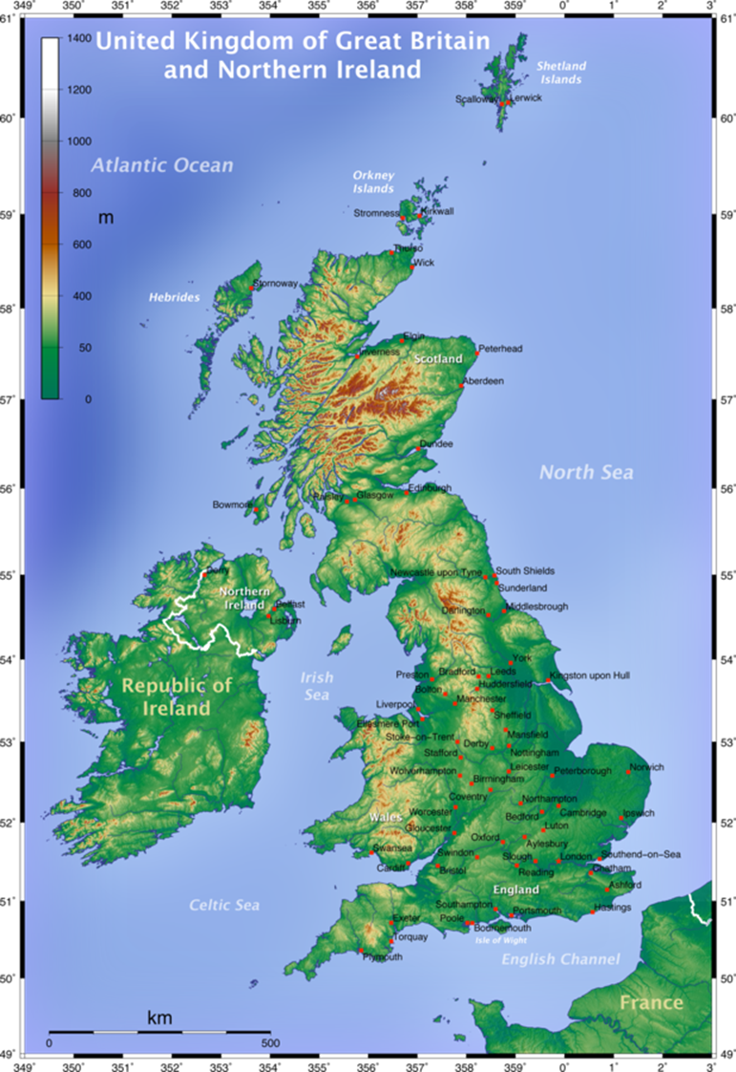
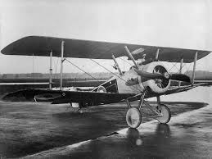
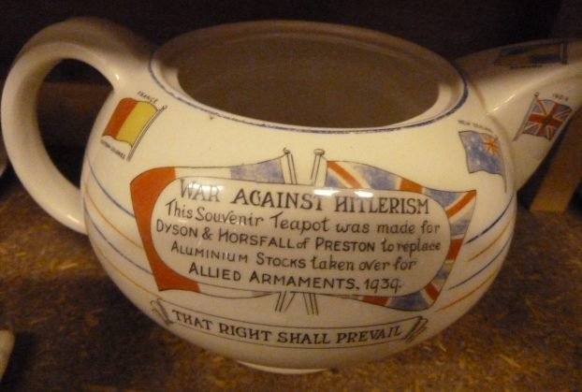
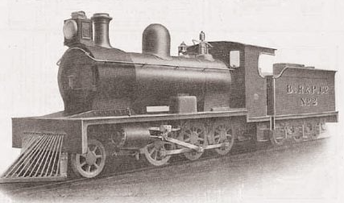
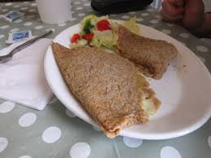
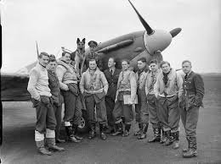
KNOWLEDGE CHECK
Where is Stoke-On-Trent? Click on the map to find out. | When did World War 1 take place?
Which of these products were made in Stoke-On-Trent in the past? | When did World War 2 take place?
1914-1918
1939-1945
Trick Question! They were all made in Stoke-On-Trent!

Slide 4
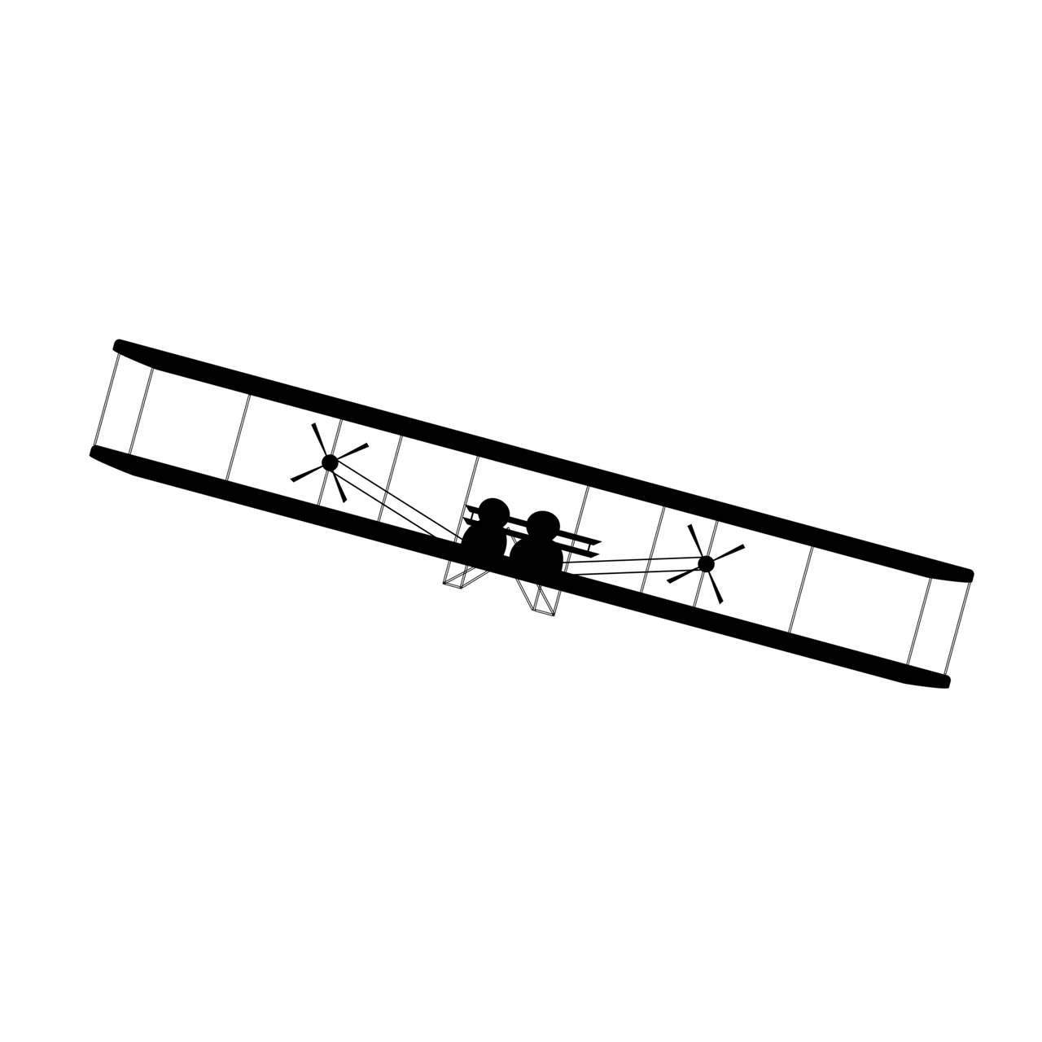
DO YOU KNOW THE NAMES OF THESE ICONIC FLYERS?
Notes:
Notes: Challenge the class to identify the iconic moments in aviation using the silhouettes. Challenge students to name specific aircraft if they can. From left to right: Wright Brothers Plane, Apollo Spaceship, Chinese Kite, Hot Air Balloon, Concorde, Spitfire.

Slide 5
IN WHAT ORDER WOULD YOU PUT THESE FLYERS AS TAKING THEIR FIRST FLIGHT?
Wright Brothers Plane
The Hot Air balloon
The Concorde
The Apollo Spacecraft
Chinese Kites
The Spitfire
Notes:
Notes: Reveal the answers to the silhouette activity, now challenge the class to put the iconic moments into historical order.

Slide 6
NOW MATCH THE DATES TO EACH FLYER…
December 1903
450 BC
March 1969
1961
1783
March 1936
Notes:
Notes: After revealing the order of these iconic moments, challenge the class to identify the order of these dates. Ask the students to explain how they are putting the dates in order (i.e. what does BC mean, how do they identify the order based upon year and month?)

Slide 7
YOUR TIMELINE SHOULD LOOK LIKE THIS
Chinese Kites
The Hot Air balloon
Wright Brothers Plane
The Spitfire
The Apollo Spacecraft
The Concorde
450 BC
1783
December 1903
March 1936
1961
March 1969
Challenge Should each of these times be equally spaced apart like they appear on the timeline?
Place the cards around your classroom to represent the time they were invented and the amount of time between the inventions.
Notes:
Notes: Challenge the class to consider the “scale” that these events are set out upon. Are all of these events happening at equal intervals of time? How can you tell? What is the biggest distance between them?

Slide 8
THE REALITY OF FLIGHT
If we map flight by spreading out each moment with the correct distance, we see that after the kite is invented, there is a substantial amount of time where no other flying invention is created… but then there is a sudden explosion of innovations!
(Today)
450 BC
0
500 AD
1000 AD
1500 AD
2000 AD
Notes:
Notes: Present the realistic timeline based upon an accurate scale. What do students notice? What does this tell you about aviation and innovation? Why might there be such a big gap between the first event, and the others? Why are so many innovations all happening closer together? What might this mean for the future?

Slide 9
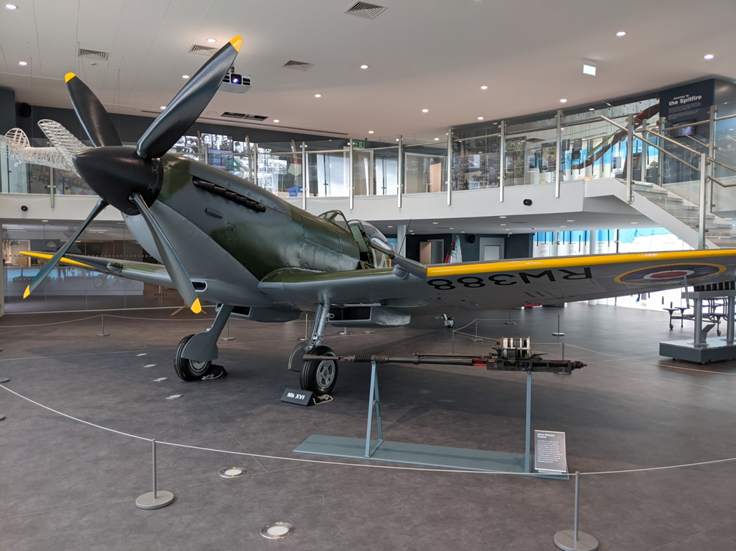
THE SPITFIRE
The Spitfire is one of the most famous World War 2 fighter aeroplanes in history.
The museum’s Spitfire is called RW388.

Slide 10
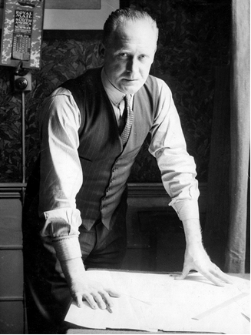
REGINALD MITCHELL
Reginald Joseph Mitchell was born in Stoke-On-Trent in 1895.
He is famous because he designed the Spitfire.

Slide 11
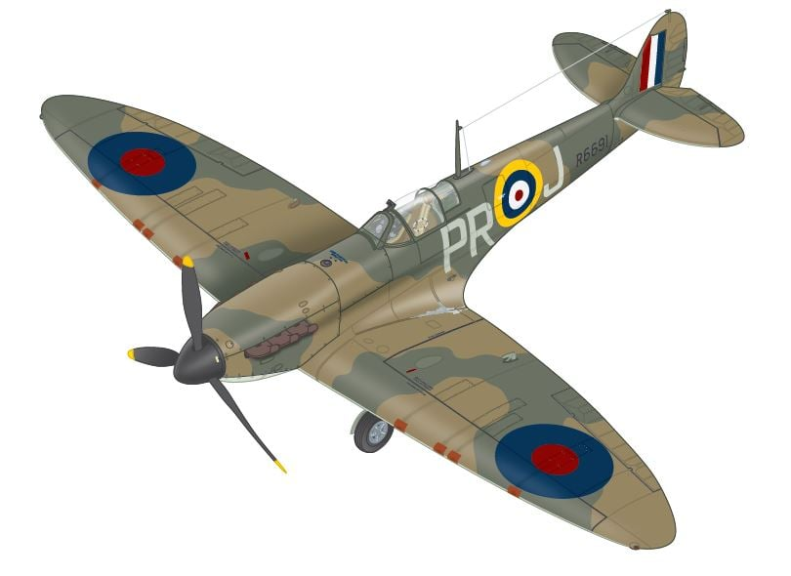
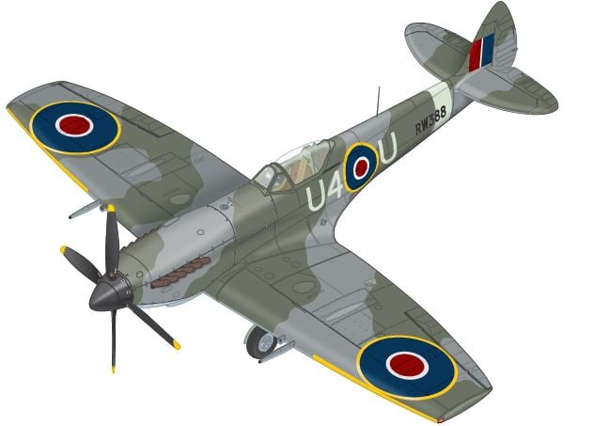
THE DEVELOPMENT OF THE SPITFIRE
More than 20,000 Spitfires were built between 1936 and 1948.
The design was adapted and developed into many different variants.
Notes:
Notes: More than 20,000 Spitfires were built between 1936 and 1948. The design was adapted and developed into many different variants. Here, we compare the Spitfire Mk.I with the museum's own Spitfire Mk.XVI.

Slide 12
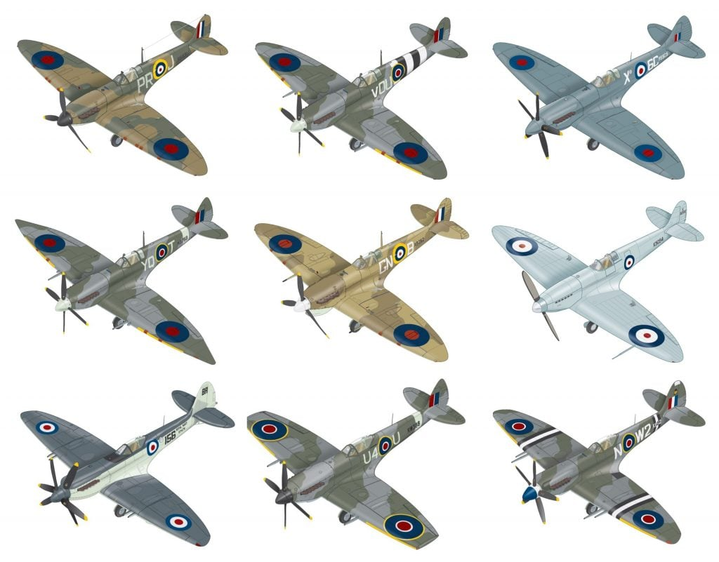
THE EVOLUTION OF THE SPITFIRE FROM MK1 TO MK16. WHAT CHANGED AND WHY?
In this lesson your students will research the different Spitfire variants. They will explain why adapting and changing the Spitfire's design was vital to the war effort.

Slide 13
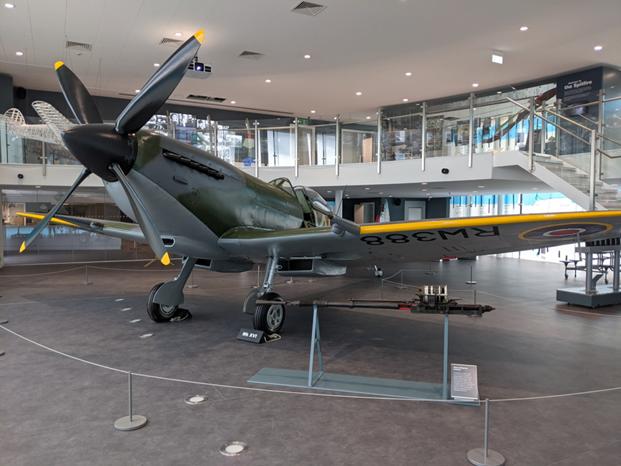
REFLECTIONS
The Operation Spitfire values are:
Creativity
Curiosity
Inclusion
Relevance
Which of these values have noticed in this lesson?
Why did the engineers working on the Spitfire persevere
throughout the war to improve the design beyond the mark one?

Slide 14
REFLECTIONS
What might have been happening during the war to motivate
the engineers and designers to continue improving the Spitfire?
What engineering opportunities are available today that would have been jobs or careers in the 1930’s, and what roles will be different?

Slide 15
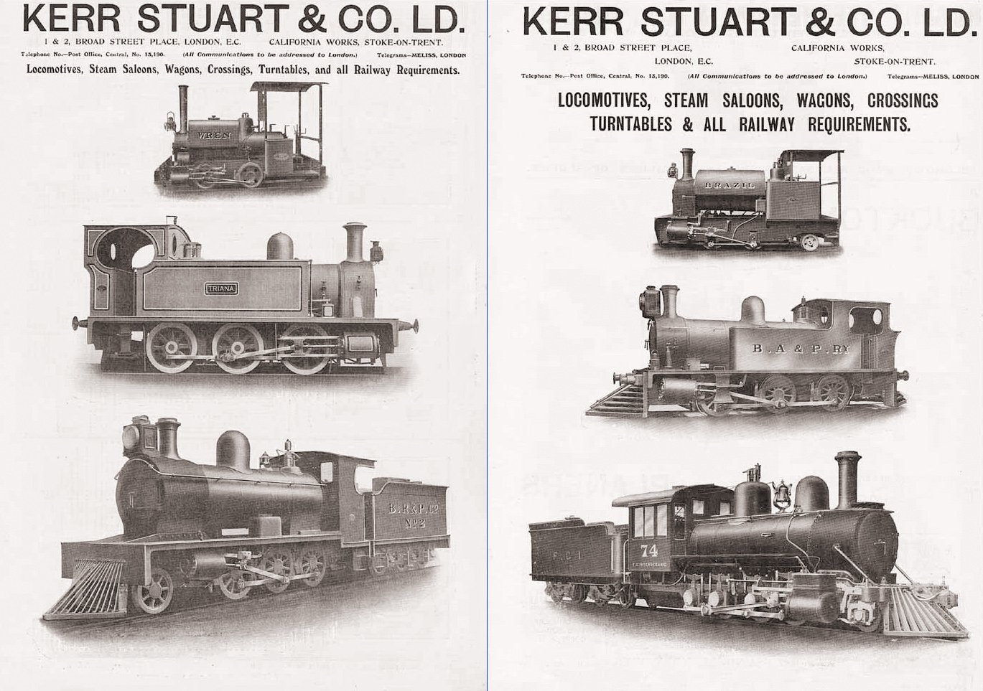
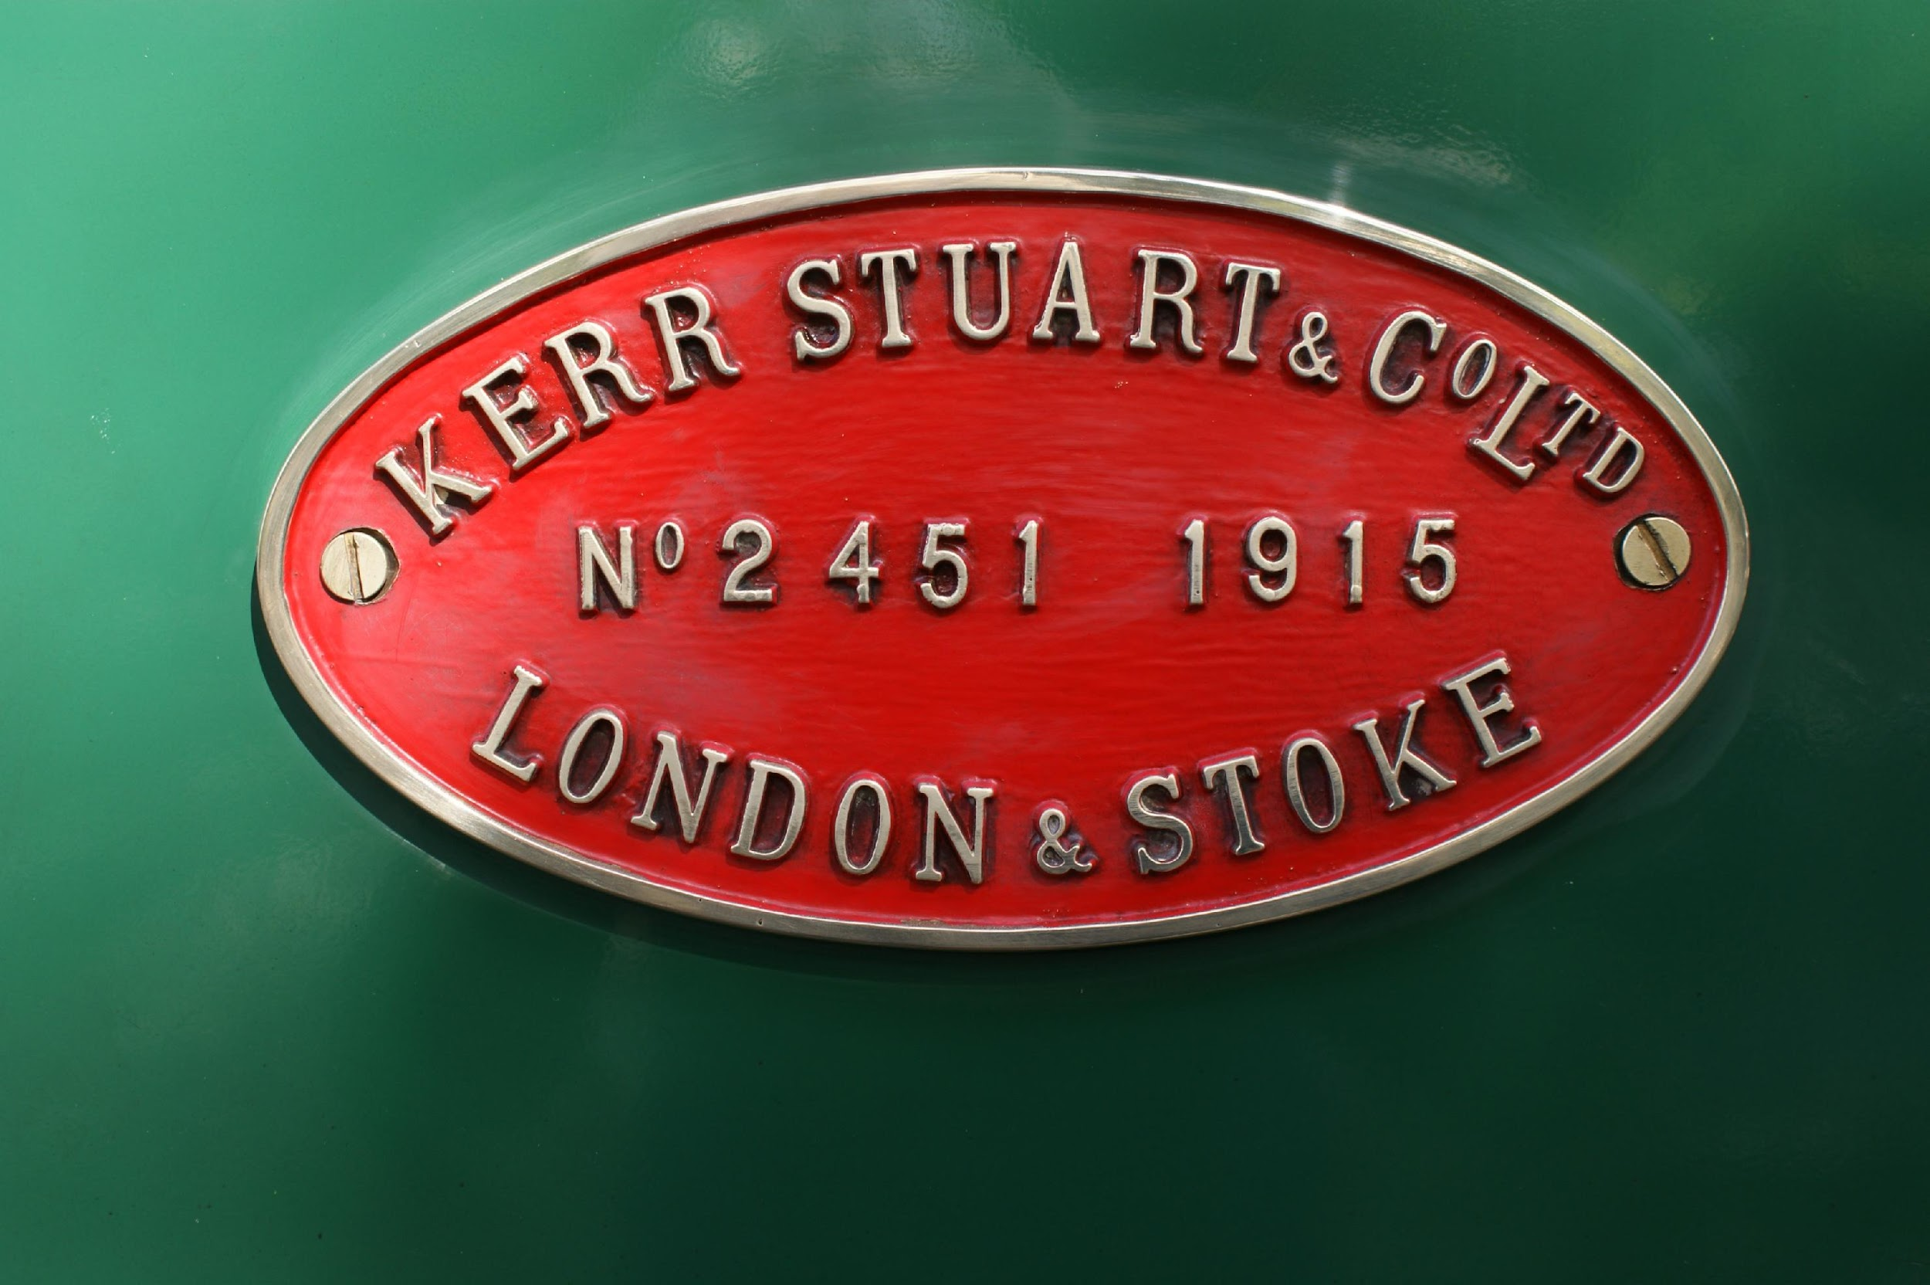
LINKS TO PAST CAREERS
Stoke-On-Trent has a rich past in engineering. Apprenticeships could be gained aged 14 from Engineering companies such as Kerr Stuart.

Slide 16
LINKS TO PRESENT CAREERS
View video on YouTube
A wide variety of apprenticeships
are available to people in Stoke-On-Trent.
JCB offer a range of apprenticeships in Engineering and Business.
The city council offers an apprenticeship scheme and Stoke-On-Trent college work with over 600 employers across a range of industries in the region, who all need skilled apprentices to make a difference in their organisation.
Notes:
Become an apprentice | Become an apprentice | Stoke-on-Trent
💬1 - Apprenticeships at Stoke on Trent College - Stoke-on-Trent College :Stoke-on-Trent College (stokecoll.ac.uk)

